Slide 1
MMI1060
Lecturer: Tanya Kirsch
Lecture 2
The Time Value of Money cont.
(Berk Ch. 4 cont. and Ch. 5)

Slide 2
Objectives for today’s lecture
To go through the homework problems from last week
To introduce an additional TVM concept: Equivalent Annual Rates (“EAR”)
To do some application TVM calculations

Slide 3
Time value of money (cont.)

Slide 4
Time Value of Money: Where are we headed?
To be able to calculate the Present Value and Future value of a stream of cash flows, at any point in time, and with any combination of the following characteristics:
Ordinary annuity and Annuity due
Perpetuity
Growing annuity and Growing perpetuity
Effective interest rates for a Quoted rate, where interest is compounded other-than-annually, and payment periods are not equal to the interest rate compounding period

Slide 5
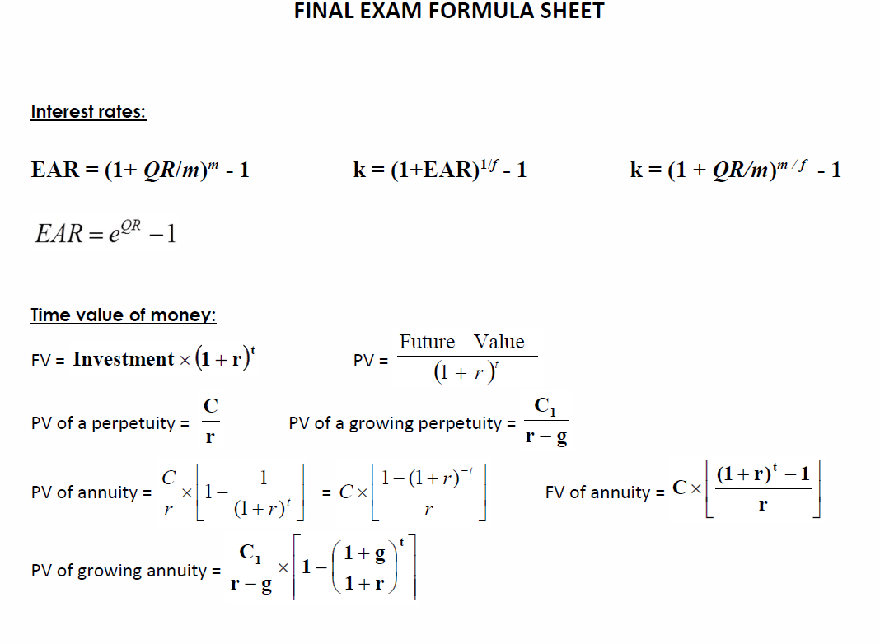
Key formulae (from the Quiz 1 formula sheet)

Slide 6
Basic problem (Booth 4th Ed. Ch 5, Q 30 – modified) – continued from last week
Mary‐Beth is planning to live in a university residence for three years while completing her degree.
The annual cost for food and lodging is $6,500 and must be paid at the end of each school year. What is the total present value of Mary‐Beth’s residence fees if the discount rate (interest rate) is 6 percent per year?
As an alternative, Mary-Beth is offered the option of paying a lower amount in her first year of $6,250, and then increasing her payment by 5% each year. Would she take this option?
How would the PV of her costs change if she had to make her payments at the beginning of each year?
For the annuity
For the growing annuity

Slide 7
Homework problem
Find the PV and FV (in 10 years from now) of a growing annuity with payments of 100 in 1 year, growing at 8% for 9 more years (i.e. 10 payments in total), if the relevant interest rate is 6% per year.
What if the payments were at the beginning of each year?
Hint: Draw a timeline to help you understand the question!

Slide 8
Amortizing loans
You borrow a lumpsum of money, and you want to pay it off over a period of time with fixed, regular payments
E.g. Car purchased with a loan from the bank; Mortgages
Each payment is a combination of interest and principal (or capital)
The loan is amortized, or paid off in full, over its amortization period
Although loan payments are equal, the interest portion decreases over time, and principal portion increases over time
Notes:
Although the loan payments will be equal if its an annuity there is also a part of that that is interest and a portion that pays down the capital or the principal and that changes every month

Slide 9
Problem #5: Amortizing loan with flat payments
We borrow $5,000 with a 10% annual interest rate, to be repaid within 3 years.
Calculate the annual payments that will exactly pay this loan off in 3 years
Draw up the amortization schedule for this loan
Notes:
Calculate with the formula (see notes view which shows the workings): (note formula uses decimals, and calculator input is in %)
Rounding to 5 decimal places
- As I pay down the loan each payment is going to be 2010.57$
Look in notes view

Slide 10
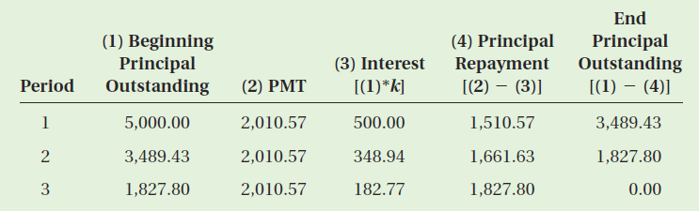
Problem #3: Amortizing loan with flat payments
The monthly payments can be calculated using a financial calculator, or the formula
The amortization table:
* Note that for each payment, a portion is for interest and a portion is for principal (/capital) repayment
Notes:
Calculate with the formula:

Slide 11
Perpetuities
Perpetuities: Cash flows of equal amount every period for an unlimited number of periods.
Example: Property tax payments, preferred stocks, etc..
Notes:
Perpetuities is when you have a stream of cash flows and they continue forever
An example is a share
The payment divided by the discount rate is the present value if the perpetuity

Slide 12
Growing Perpetuities
The present value of a constant growth perpetuity:
Equation holds only when k > g, the discount rate is greater than the growth rate. Otherwise, the answer is becomes negative and has no practical interpretation.
Note that g can be > k in a growing annuity calculation (unlike the perpetuity calc)
Only future estimated cash flows and estimated growth in these cash flows are relevant, while past cash flows are not.
Notes:
- A rogers share where the payments grow?

Slide 13
In-class Problem #4: Growing / Shrinking Perpetuity
Shirley has been offered two perpetuities: Grow and Shrink.
Grow promises her $100 at the end of this year, followed by an annual cash flow that will increase by 4 percent per year forever.
Shrink promises her $1,000 at the end of this year, but the annual cash flow will decline by 2 percent forever.
If her opportunity cost is 5% per year, which perpetuity has the greater value?
Source: Booth, 4th Ed, Ch 5, Q44
Notes:
1) grow – increase by 4% per year forever

Slide 14
APR real-life example (car loan)
Notes:
https://www.youtube.com/watch?v=BRvWxR6RnGw

Slide 15
Introducing Effective Annual Rates
Examples until now have assumed that there is no compounding of interest during a year. What happens if we compound interest semiannually, or quarterly? What happens to the effective annual rate (“EAR”)?
Problem: You have $100, and the quoted interest rate is 10%
Annual compounding: $100 => 100(1.1) = $110 in 1 year
But: If we compound semi-annually: we are growing at 5% every six months, i.e.:
$100 => 100(1.05) = $105 in a half year, and
$100 => 100(1.05²) = $110.25 in 1 year
So what then is an effective annual rate?
Notes:
EAR therefore is:
$100(1 + r)^1 = 110.25
Timeline:
0 to ½: x 1.05
½ to 1: x 1.05 again
So annual = x1.05^2
What happens when you start compounding interest
The more frequently you compound your interest rate the bigger your future value is going to be

Slide 16
Interest rates: Effective Annual Rates vs Nominal rates
Effective Annual Interest Rate [EAR]: Interest rate that is annualized using compound interest
If m is the number of compounding periods per year, then we can say:
EAR = (1 + rate per compounding period)No. of compounding periods in a year - 1
Note: Nominal (uncompounded) rates are also called “Quoted rates” and “Annual Percentage rates (APR)”
Notes:
QR is quoted rate which was 10%
M is compounding periods which is 2

Slide 17

Compounding
As we increase the interest compounding frequency, we increase the effective annual rate.
As m becomes infinite, we achieve continuous compounding:
12% Compounded | Effective Annual Rate
Annually (m = 1) | 12.0000%
Semi-annually (m = 2) | 12.3600%
Quarterly (m = 4) | 12.5509%
Monthly (m = 12) | 12.6825%
Daily (m = 365) | 12.7478%
Continuously (m = ∞) | 12.7497%
$${\left(1+\frac{0.12}{2}\right)}^{2}$$
Notes:
e = 2.71828…
e = the impact of compound, continuous growth, where every nanosecond (or faster) you are growing just a little bit.
e shows up whenever systems grow exponentially and continuously: population, radioactive decay, interest calculations, and more

Slide 18
Canadian mortgages and the EAR
Examples until now have assumed annual payments
But: Canadian banking regulations require Canadian financial institutions to compound mortgage rates semi-annually even though they quote rates on an annual uncompounded basis
And: Mortgages are often paid monthly
This is confusing:
Quoted rates are non-compounded annual rates (i.e. Nominal rates)
Interest rates must be compounded semi-annually, and
Mortgages are paid monthly, or sometimes even weekly
Notes:
Examples until now have been annual
In Canada there are regulations as to how often banks can compound interest
The banks would like to compound interest as frequently as possible
The regulations are that they can only do this semi annually (so they don’t rip you off too much).
Disconnect between compounding and actual mortgage calculations

Slide 19
Canadian mortgages and the EAR (cont.)
So, quoted rates are uncompounded annual rates (APR’s)
To calculate the appropriate monthly interest rate, our first step is to calculate the EAR:
Notes:
We need to take our uncompounded rate and convert it to and uncompounded semi annual rate
IF YOU ARE paying monthly you need to figure out the monthly interest rate that you can use to get tot your monthly mortgage rate

Slide 20
But the payments aren’t annual?
Next, we need to find the rate per payment period (say, “k”) so that (1+k)(1+k)….multiplied out by the number of payments per year (“f”) will give us the EAR.
i.e. if payments are monthly: (1+k)¹² = 1+EAR
Rearranged: k = (1+EAR)^{1/12} - 1
This tells us what the effective interest rate is (sometimes shown as k) for the payment period – i.e. if payments are weekly, this gives us the effective interest rate for a week.
Rate per payment period = (1 + EAR)^{1/f} – 1
k = (1 + EAR)^{1/f} – 1
Notes:
Let’s say you have quarterly payments: (1 + ?)(1+ ?)(1 + ?)(1 + i) = EAR
So ? =
Rate per payment period is k
Effective interest rate is often depicted as k

Slide 21
But the payments aren’t annual?
The two steps in the previous slides can be combined into one “summary” formula:
Where:
f = no. of payment periods (e.g. 12 if paying monthly)
k = rate per payment period (e.g. monthly rate)
QR = Quoted rate
m = no. of compounding periods (e.g. 2 if compounding semiannually
K is the effective interest rate per payment period (e.g. the effective monthly interest rate)

Slide 22
Some more on Canadian mortgages…
Term of a mortgage = the period for which the bank commits to a quoted rate
Amortization period = the period over which you will pay off your mortgage
E.g. The mortgage has a term of 5 years (i.e. the Quoted rate = 7.75% for 5 years) and an amortization period of 25 years

Slide 23
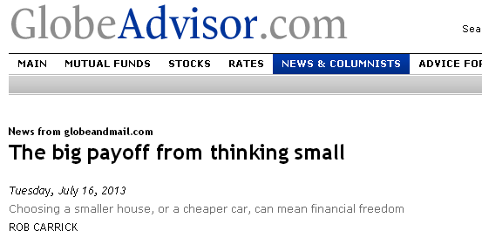
Application: Mortgage problem
…The average Canadian home sold for $386,585 in June, which means monthly payments of $1,865 if you assume a 3.39 per cent fixed five-year mortgage rate and a 5 per cent down payment. If prices fell 5 per cent and mortgage rates increased by half a percentage point, the monthly payment is pretty much the same….
https://secure.globeadvisor.com/servlet/ArticleNews/story/gam/20130716/GICARRICK0715ATL
To do:
Recalculate the monthly payment based on the current average price and mortgage rate (assume a 25 year amortization period) – see if you get the same answer as the Globe reporter got
Notes:
See separately posted note for workings.

Slide 24
Homework problem #1
…The average Canadian home sold for $386,585 in June, which means monthly payments of $1,865 if you assume a 3.39 per cent fixed five-year mortgage rate and a 5 per cent down payment. If prices fell 5 per cent and mortgage rates increased by half a percentage point, the monthly payment is pretty much the same….
https://secure.globeadvisor.com/servlet/ArticleNews/story/gam/20130716/GICARRICK0715ATL
Homework:
Prove that if prices fell by 5% and mortgage rates increased by half a % (i.e. to 3.89%), the monthly payment would be the same
Notes:
See separately posted note for workings.

Slide 25
Key formulae (from the Quiz 1 formula sheet)

Slide 26
Homework problem #2
Which investment would you choose to invest in if:
Your discount rate is 10%?
Your discount rate is 15%?
 | Cost of investment | Income in year 1 | Income in year 2
Investment A | -$30,000 | $21,000 | $21,000
Investment B | -$50,000 | $33,000 | $33,000
Notes:
NPV A = 6,446
NPV B = 7273
IRR A = 25.7%
IRR B = 20.7%

Slide 27
Objectives for today’s lecture
To go through the homework problem from last week
To introduce an additional TVM concept: Equivalent Annual Rates (“EAR”)
To do some TVM application calculations

Slide 28
Forthcoming attractions
Next week: Ch 8 – Capital Budgeting tools (NPV, IRR, Payback and Discounted payback)
Quiz 1:
Thurs, Oct 10 (16h10 – 17h00 => during tutorial)

